Slide 1
Project Report Autonomous Driving
Tianshu Zhu, Haoran Fang

Slide 2
Compute Disparity
we reused the code “spsstereo” from TTIC Chicago to compute the disparity between left and right image.

Slide 3
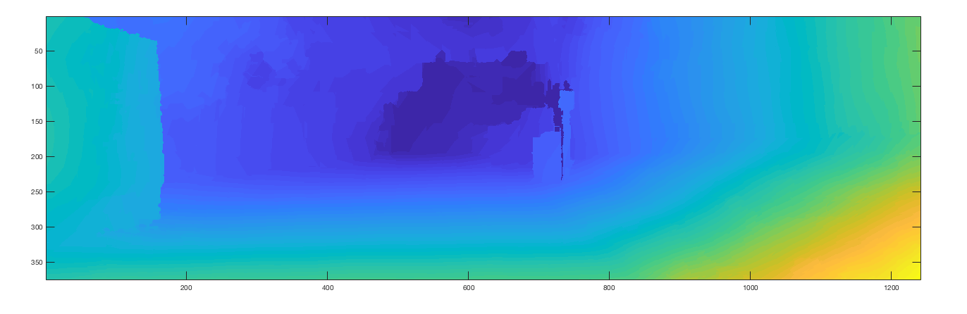
Disparity result

Slide 4
Compute depth and 3D location
We used the same method that are used in a4 to compute them.

Slide 5
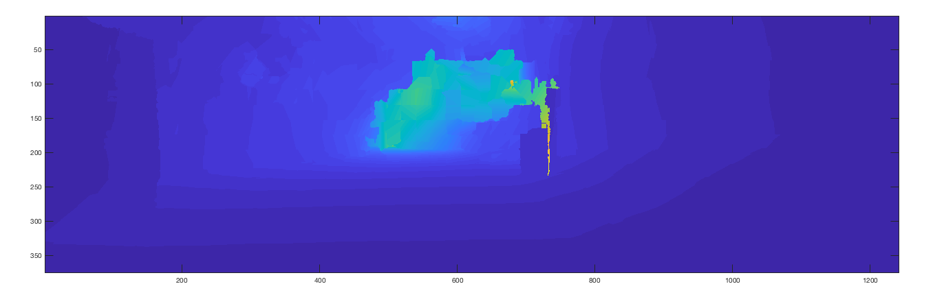
Depth result

Slide 6
Segmentation
Used “matlab’s superpixel()” function to do segmentation. In order to classify road

Slide 7
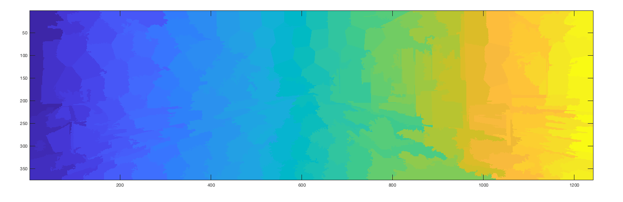
Segmentation result

Slide 8
Classify road
Used histogram of hue, std of hue, mean 2D x, mean 2D y, mean 3D y, min 3D y, max 3D y, std 3D y as training features .
Used around 54200 superpixels for training and around 13550 superpixels for testing.
Trained a binary SVM classifier using python sklearn.
Train accuracy: 0.93611
Test accuracy: 0.92537

Slide 9
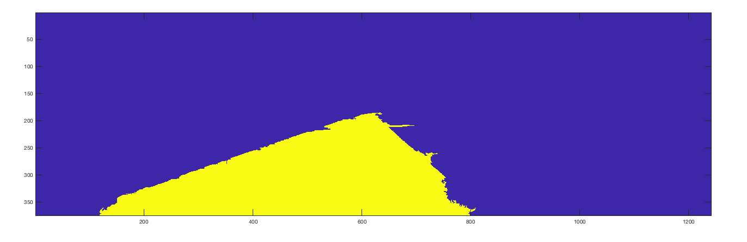
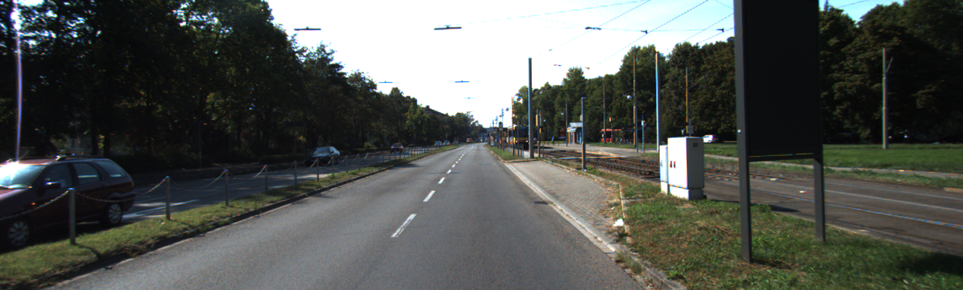
Classification result

Slide 10
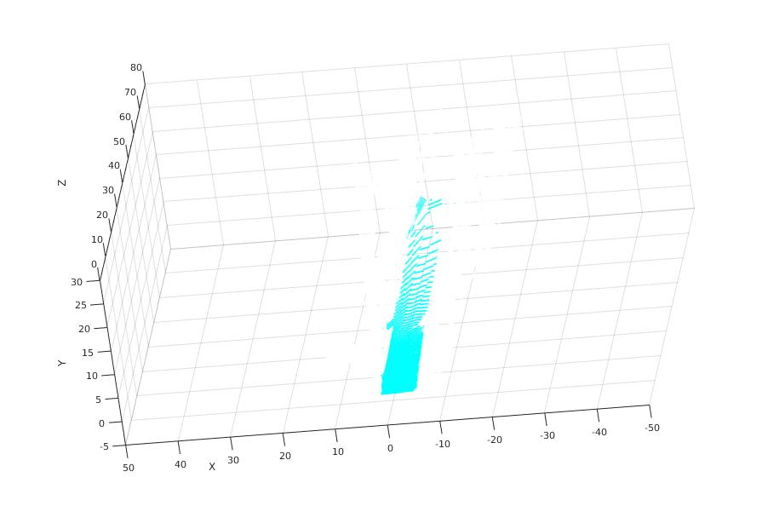
Fit a plane
We extract the location of road and plot it in the 3d space

Slide 11
Plot Road in 3D
We marked the road as 255 and the rest as 0.
Set a filter to mark each pixel on sample image which considered as road
Mark road with red color
Relate marked-picture with 3d location file
Plot road in 3d-space

Slide 12
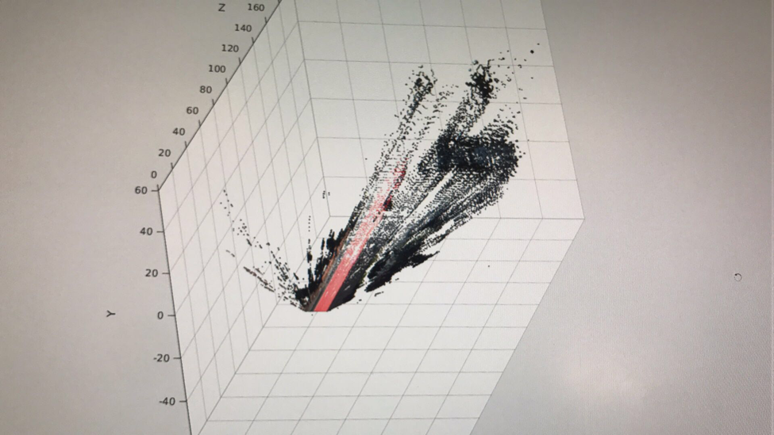
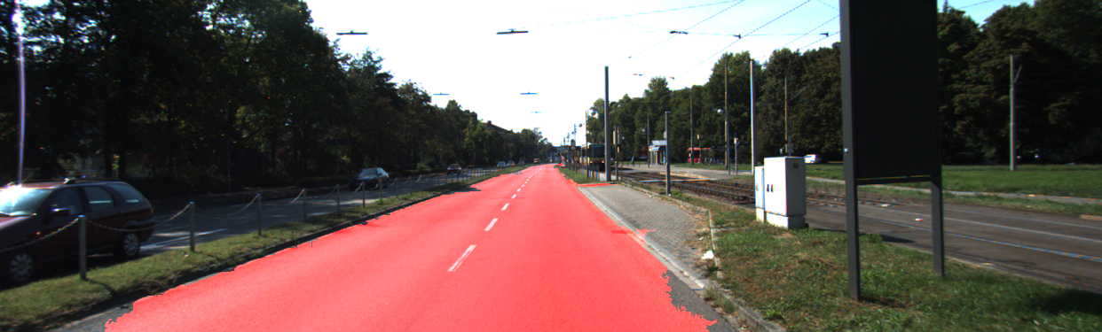
Plot result

Slide 13
Car detection and segmentation
Used “DPM” detector provided in a4 to detect cars
Did basic segmentation for each car based on 3D location. Computed centre 3D location of each car.

Slide 14
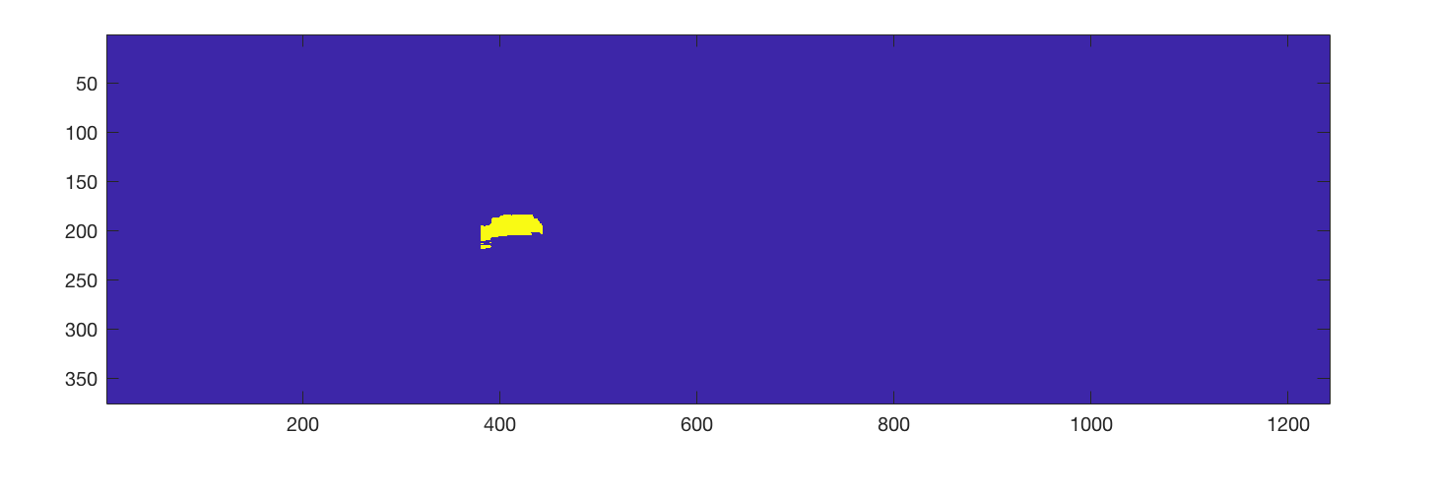
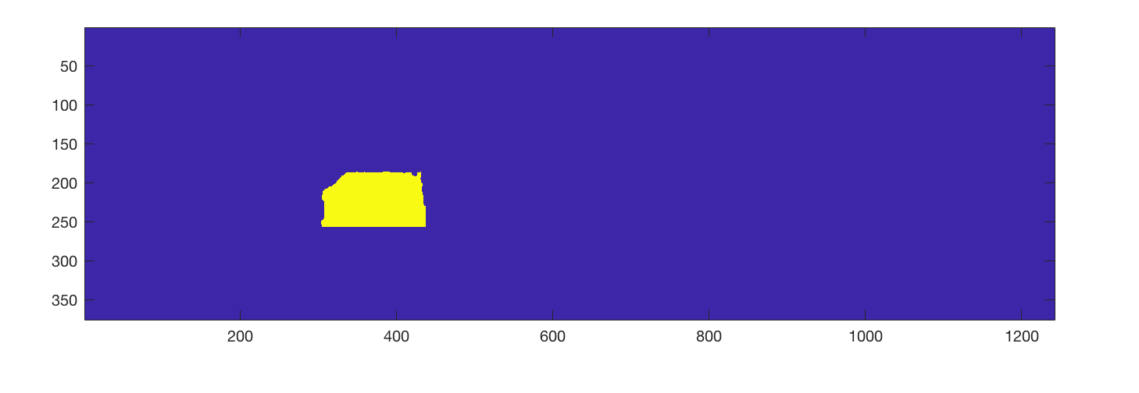
Car segmentation result

Slide 15
Classify car orientation
Used “Matlab’s extractHOGFeatures()” to extract hog features of detected patches of cars.
Used Hog and downsampled HSV raw image as training features.
Used 10000 cars for training and 2000 for testing.
Trained a 12 class SVM classifier.
Train accuracy: 0.7279.
Test accuracy: 0.7040

Slide 16
2D box and orientation
By extracting info from label, we got location of 2d bounding box
Drew lines to form rectangles on each detected cars.
Used rotation-y from object to calculate orientation on each detected car
drew a line on box for each car’s orientation

Slide 17
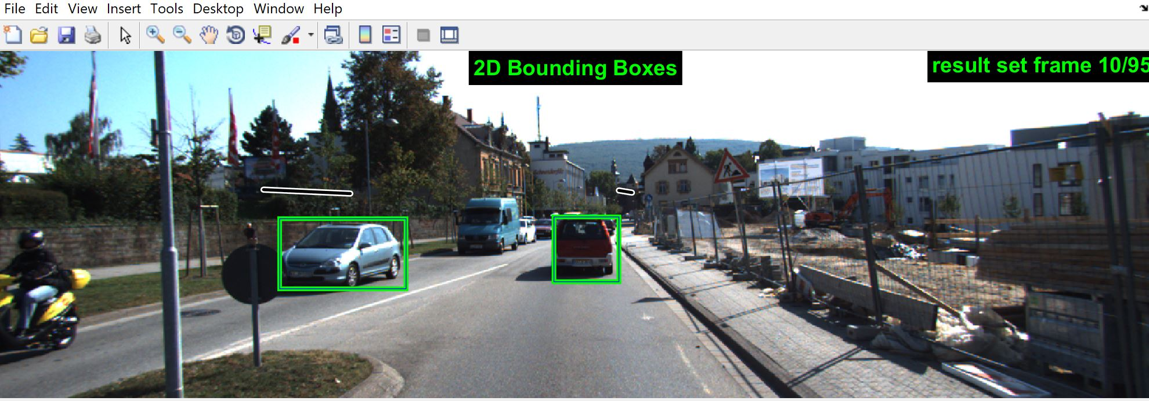
2D box and orientation result

